Slide 1
Time series analysis
Prof. dr. Rens Vliegenthart
Guest lecture
Big Data and Automated Content Analysis
April 14, 2020

Slide 2
Part 1
Data and characteristics

Slide 3
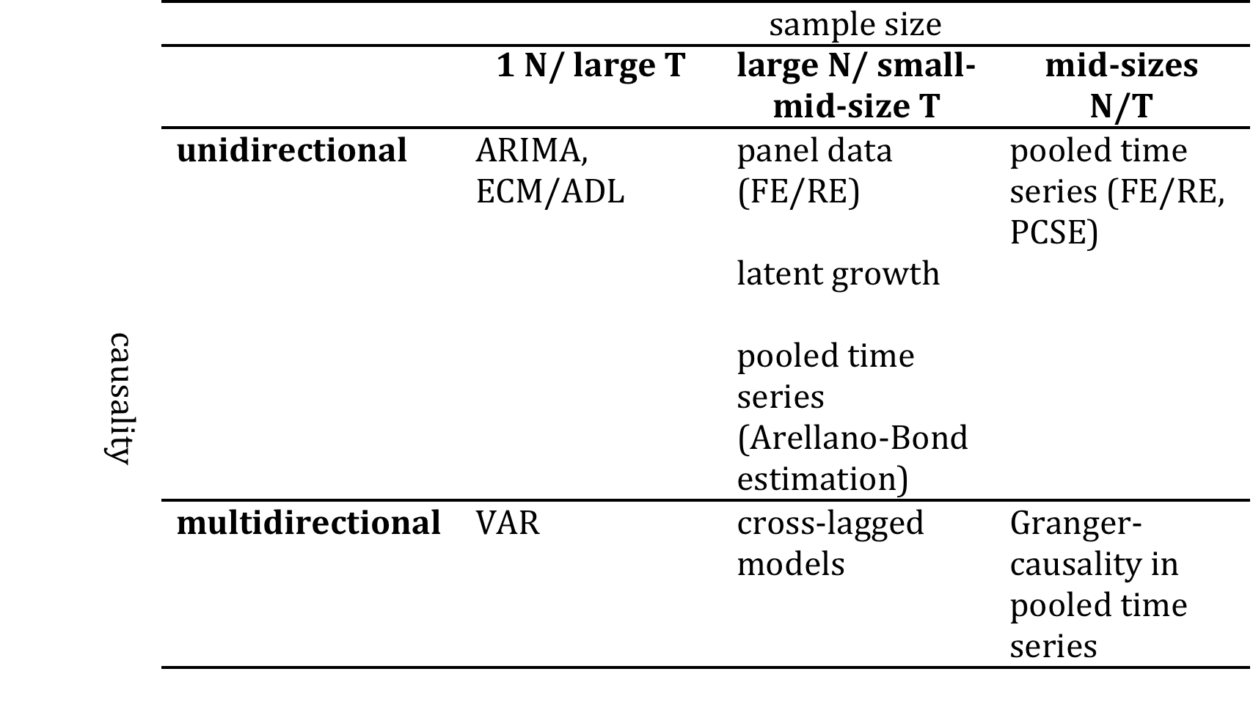
Techniques
R. Vliegenthart
- <number> -

Slide 4
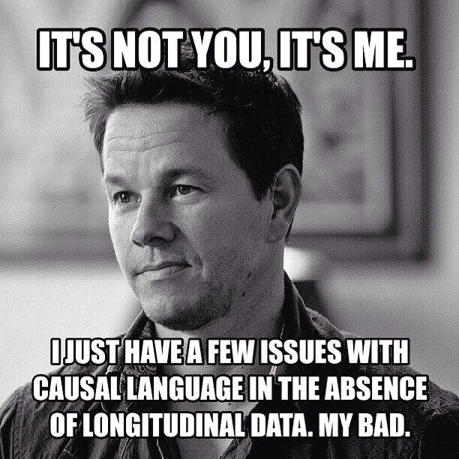
Time and causality
R. Vliegenthart
- <number> -

Slide 5
Dynamic data analysis
Statistically, in a lot of cases were ‘dynamic data analysis’ is applied, the assumption of independence of observations is violated.
This means that residuals are correlated (over time, or across units that are measured at the same time).
This needs to be ‘solved’ statistically
R. Vliegenthart
- <number> -

Slide 6
Simple solutions: the LDV model
The lagged dependent variable covers the basis idea that the current value depends on the previous value.
Simply put: the best prediction for today’s standing of a party in the polls is yesterday’s standing.
This can be done easily within the OLS framework.
It’s a pretty good start!
R. Vliegenthart
- <number> -

Slide 7
Including a trend variable
Some variables have the tendency to grow over time - e.g. economic indicators such as economic growth
Not taking this into account can result in spurious relations
Include point of measurement as an independent variable
R. Vliegenthart
- <number> -

Slide 8
Part 2
Autocorrelation, seasonality and stationarity

Slide 9
Stationarity
Mean should not depend upon time of observation. In other terms: the unstandardized coefficient predicting the current value from the previous value should not be larger than one.
Dickey Fuller test
R. Vliegenthart
- <number> -

Slide 10
Non-stationarity
‘Hendry's theory of inflation is that a certain variable (of great interest in this country) is the "real cause" of rising prices. I am "certain” that the variable (denoted C) is exogenous, that causality is from C to P only and (so far as I am aware) that C is outside government control although data are readily available in government publications’ (Hendry, 1980: 392).
R. Vliegenthart
- <number> -

Slide 11
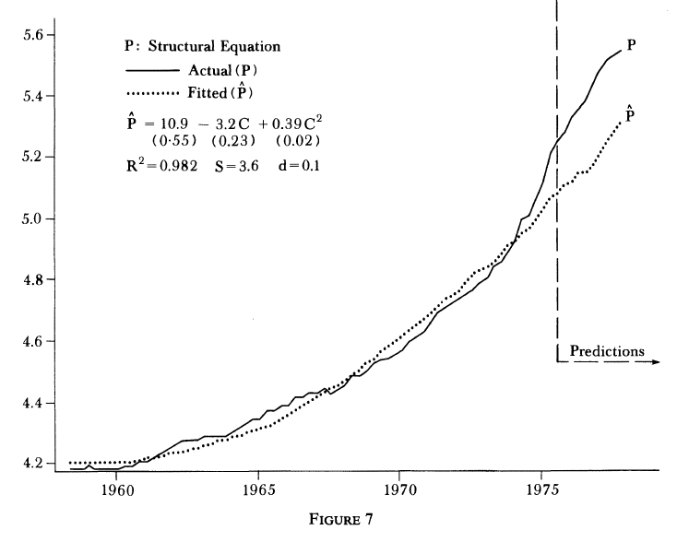
Stationarity
R. Vliegenthart
- <number> -
Hendry, 1980

Slide 12
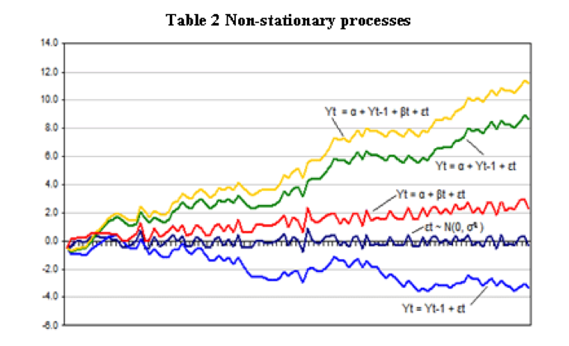
Non-stationary processes
R. Vliegenthart
- <number> -

Slide 13
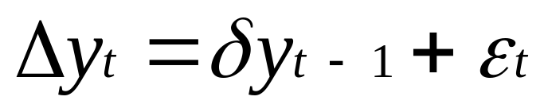
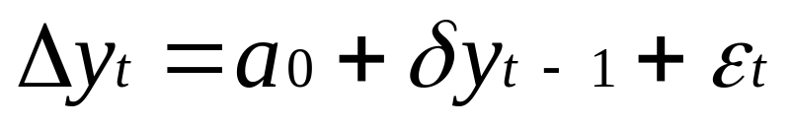
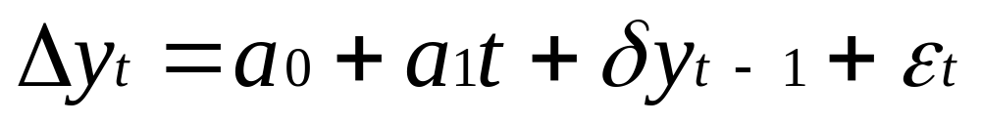
Dickey-Fuller test
Random walk without drift
Random walk with drift
Random walk with drift and trend
R. Vliegenthart
- <number> -
Notes:
Null hypohesis: unit root (delta=0). If delta>0 – increments smaller with higher scores on previous y: moving back to mean, thus stationary.

Slide 14
Autocorrelation
Current values depend on previous values
Not taken into consideration: spurious results
Also: seasonal autocorrelation
R. Vliegenthart
- <number> -

Slide 15
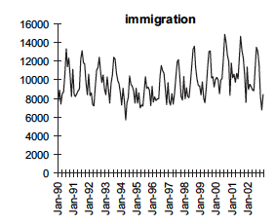
Seasonality
R. Vliegenthart
- <number> -

Slide 16
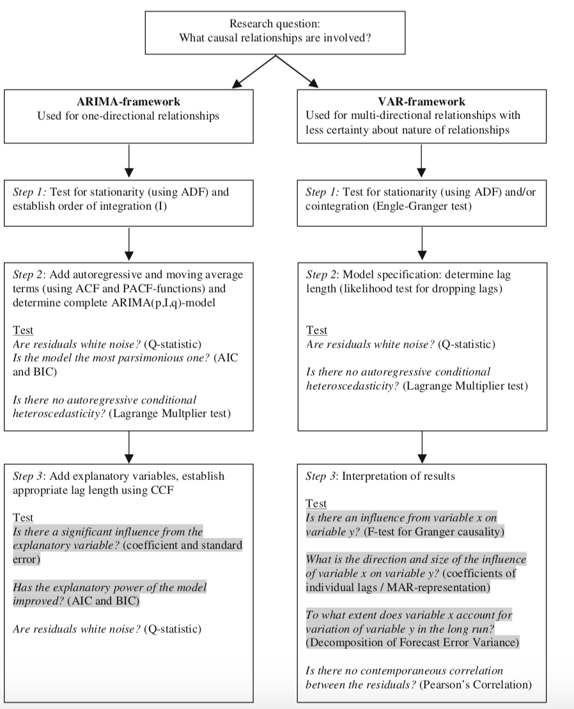
ARIMA and VAR
R. Vliegenthart
- <number> -

Slide 17
Part 3
Vector Autoregression

Slide 18
Vector Autoregression
Assumptions about causality: limited or none!
Not so different from OLS
R. Vliegenthart
- <number> -

Slide 19
Granger causality
y Granger-causes z:
The prediction of the z based on its own past improves when adding y’s past to the equation
R. Vliegenthart
- <number> -

Slide 20
Stationarity
VAR requires stationarity
In some cases two variables are non-stationary, but a linear combination of the two is: use VECM (not discussed today)
R. Vliegenthart
- <number> -

Slide 21
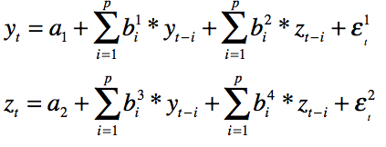
VAR in an equation
R. Vliegenthart
- <number> -

Slide 22
Adding multiple lags
Based on fit-statistics
Interpretation of individual coefficients might be difficult due to multi-collinearity
R. Vliegenthart
- <number> -

Slide 23
Running the VAR
Granger-causality test
Decomposition of forecast error variance
Impulse response analysis
(Squared) residuals white noise?
R. Vliegenthart
- <number> -

Slide 24
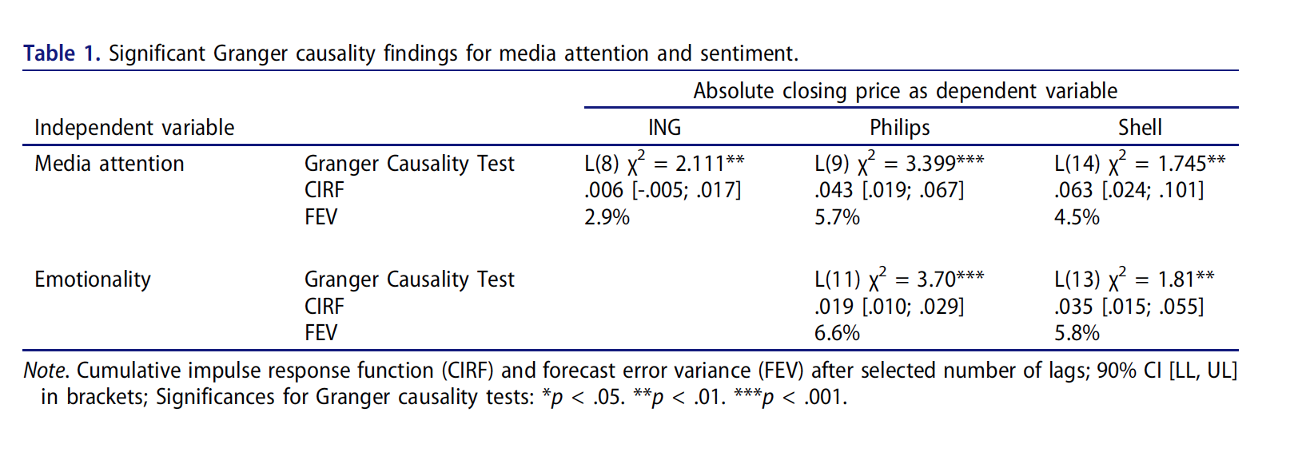
Reporting (1)
Strycharz, Strauss, & Trilling, 2017
R. Vliegenthart
- <number> -

Slide 25
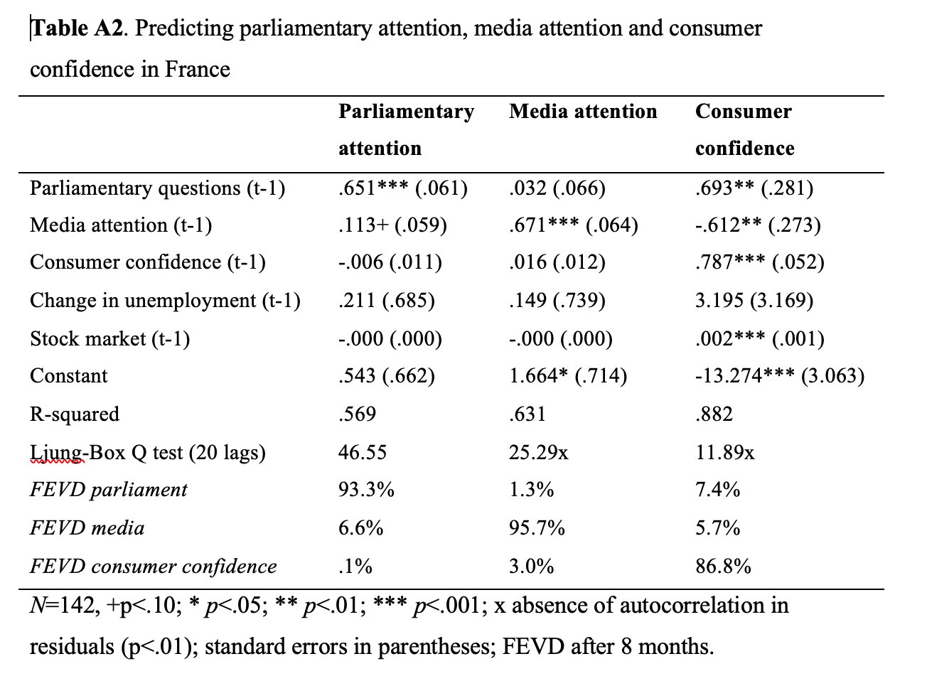
Reporting (2)
Vliegenthart & Damstra, 2019
R. Vliegenthart
- <number> -

Slide 26
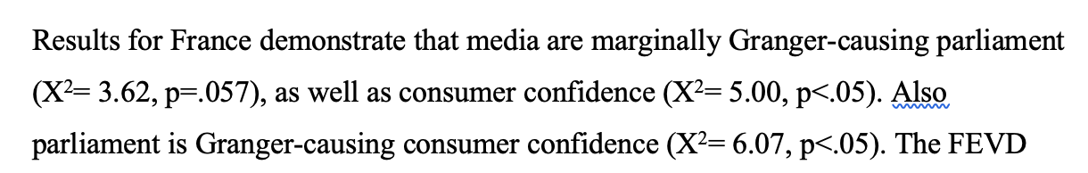
Reporting (2)
Vliegenthart & Damstra, 2019
R. Vliegenthart
- <number> -

Slide 27
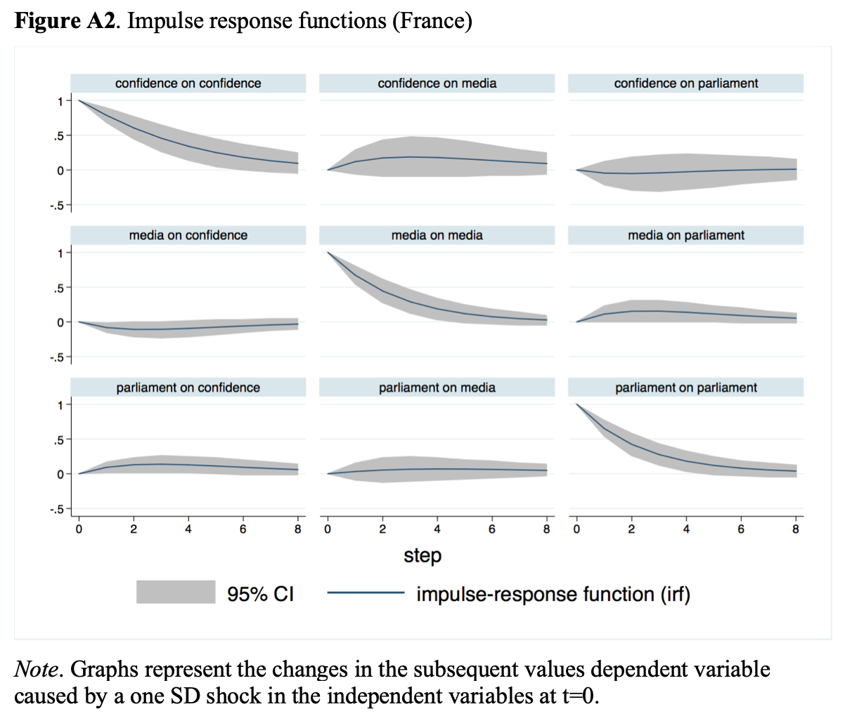
Reporting (4)
Vliegenthart & Damstra, 2019
R. Vliegenthart
- <number> -

